Slide 1
Chapter 9 – Classification and Regression Trees
Data Mining for Business Intelligence
Shmueli, Patel & Bruce

Slide 2
Trees and Rules
Goal: Classify or predict an outcome based on a set of predictors
The output is a set of rules
Example:
Goal: classify a record as “will accept credit card offer” or “will not accept”
Rule might be “IF (Income > 92.5) AND (Education < 1.5) AND (Family <= 2.5) THEN Class = 0 (nonacceptor)
Also called CART, Decision Trees, or just Trees
Rules are represented by tree diagrams

Slide 3
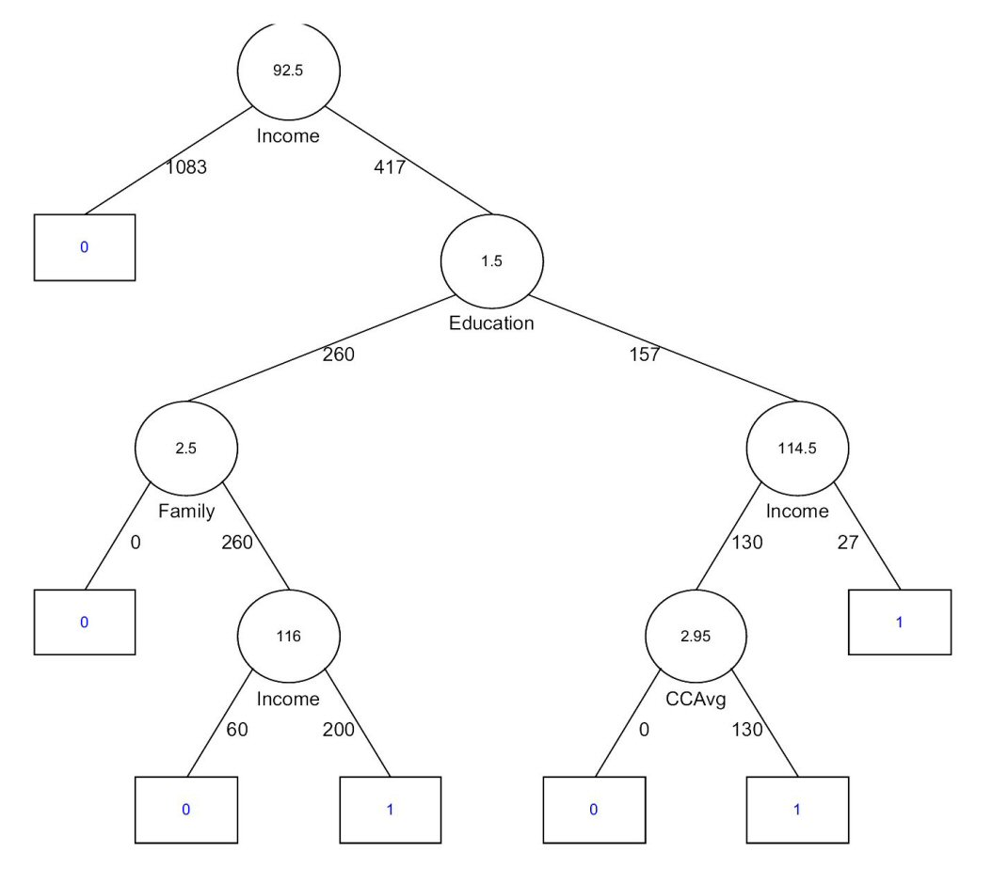

Slide 4
Key Ideas
Recursive partitioning: Repeatedly split the records into two parts so as to achieve maximum homogeneity within the new parts
Pruning the tree: Simplify the tree by pruning peripheral branches to avoid overfitting

Slide 5
Recursive Partitioning

Slide 6
Recursive Partitioning Steps
Pick one of the predictor variables, x_{i}
Pick a value of x_{i,} say s_{i}, that divides the training data into two (not necessarily equal) portions
Measure how “pure” or homogeneous each of the resulting portions are
  “Pure” = containing records of mostly one class
Algorithm tries different values of x_{i,} and s_{i} to maximize purity in initial split
After you get a “maximum purity” split, repeat the process for a second split, and so on

Slide 7
Example: Riding Mowers
Goal: Classify 24 households as owning or not owning riding mowers
Predictors = Income, Lot Size

Slide 8
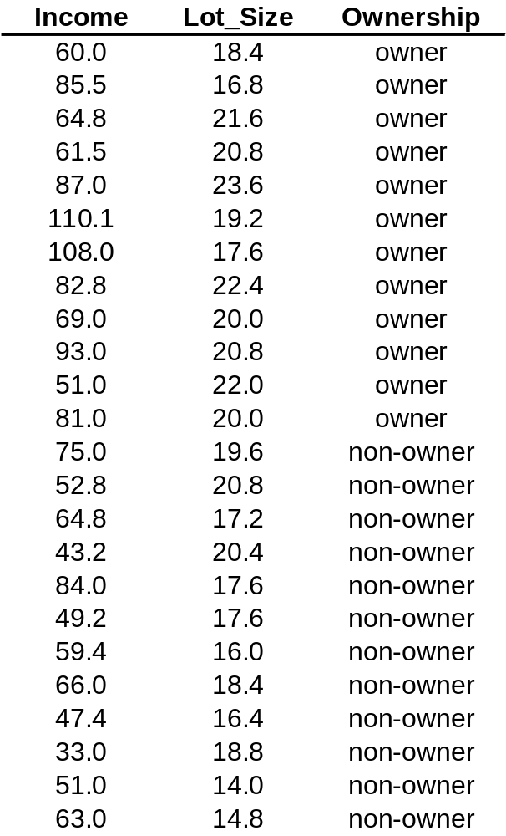

Slide 9
How to split
Order records according to one variable, say lot size
Find midpoints between successive values
    E.g. first midpoint is 14.4 (halfway between 14.0 and 14.8)
Divide records into those with lotsize > 14.4 and those < 14.4
After evaluating that split, try the next one, which is 15.4 (halfway between 14.8 and 16.0)

Slide 10
Note: Categorical Variables
Examine all possible ways in which the categories can be split.
E.g., categories A, B, C can be split 3 ways
  {A} and {B, C}
  {B} and {A, C}
  {C} and {A, B}
With many categories, # of splits becomes huge
XLMiner supports only binary categorical variables

Slide 11
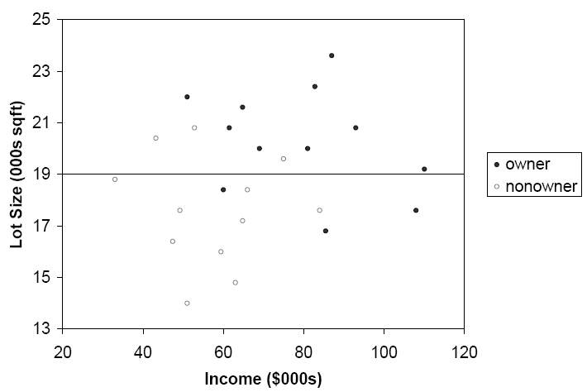
The first split: Lot Size = 19,000

Slide 12
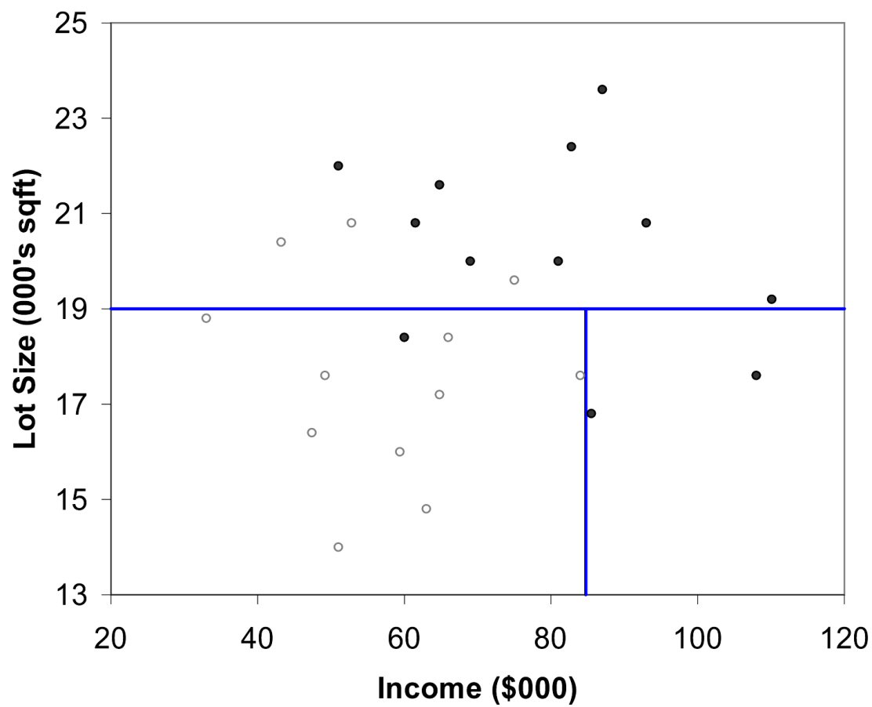
Second Split: Income = $84,000

Slide 13
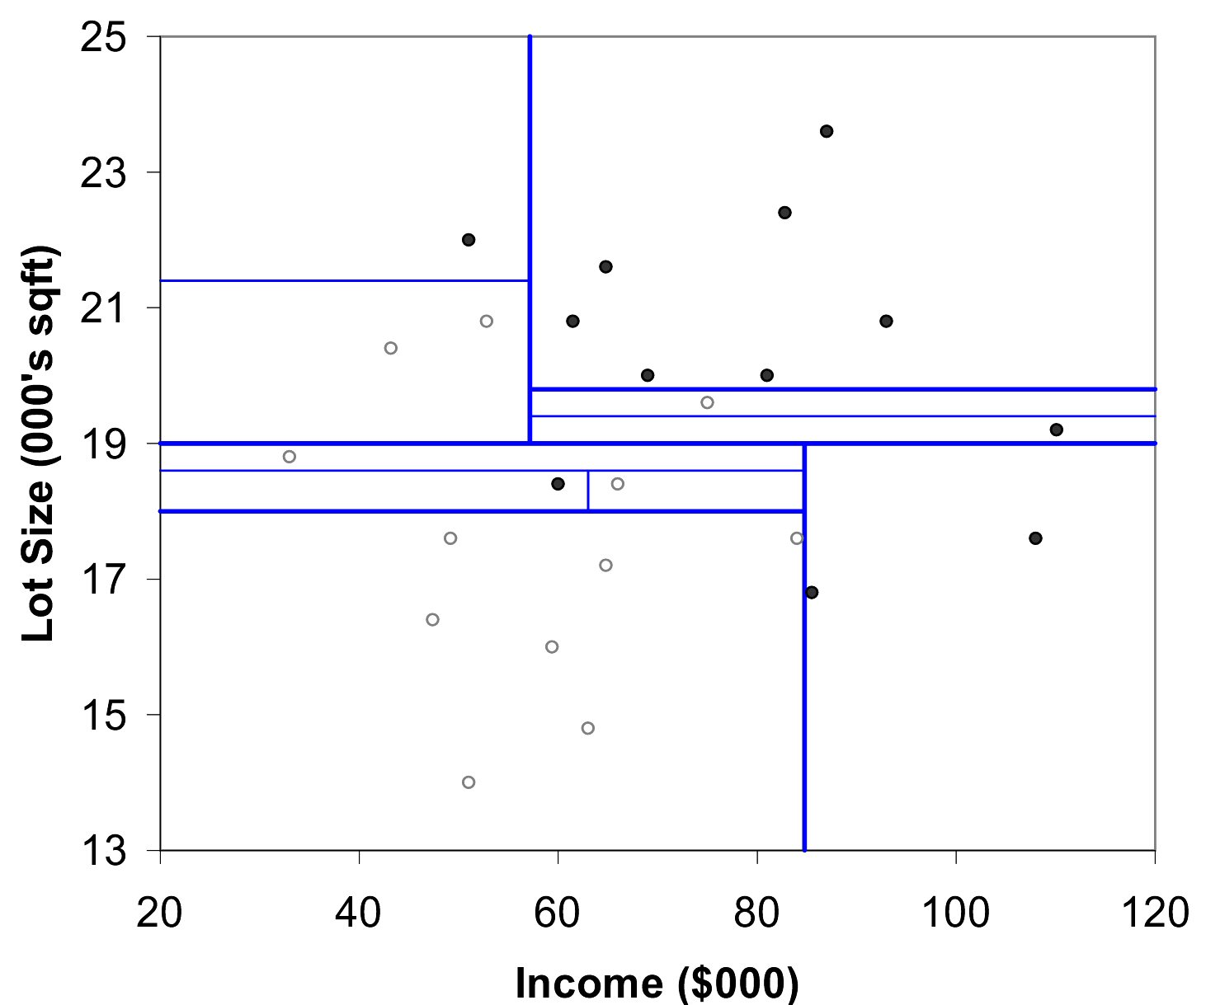
After All Splits

Slide 14
Measuring Impurity

Slide 15
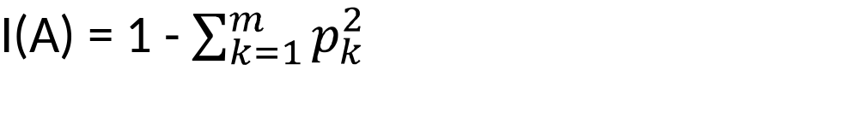
Gini Index
Gini Index for rectangle A containing m records
p = proportion of cases in rectangle A that belong to class k
  I(A) = 0 when all cases belong to same class
  Max value when all classes are equally represented (= 0.50 in binary case)
Note: XLMiner uses a variant called “delta splitting rule”

Slide 16
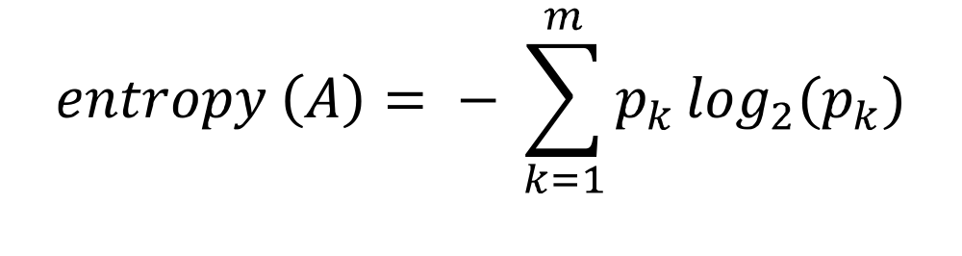
Entropy
p = proportion of cases (out of m) in rectangle A that belong to class k
Entropy ranges between 0 (most pure) and log₂(m) (equal representation of classes)

Slide 17
Impurity and Recursive Partitioning
Obtain overall impurity measure (weighted avg. of individual rectangles)
At each successive stage, compare this measure across all possible splits in all variables
Choose the split that reduces impurity the most
Chosen split points become nodes on the tree

Slide 18
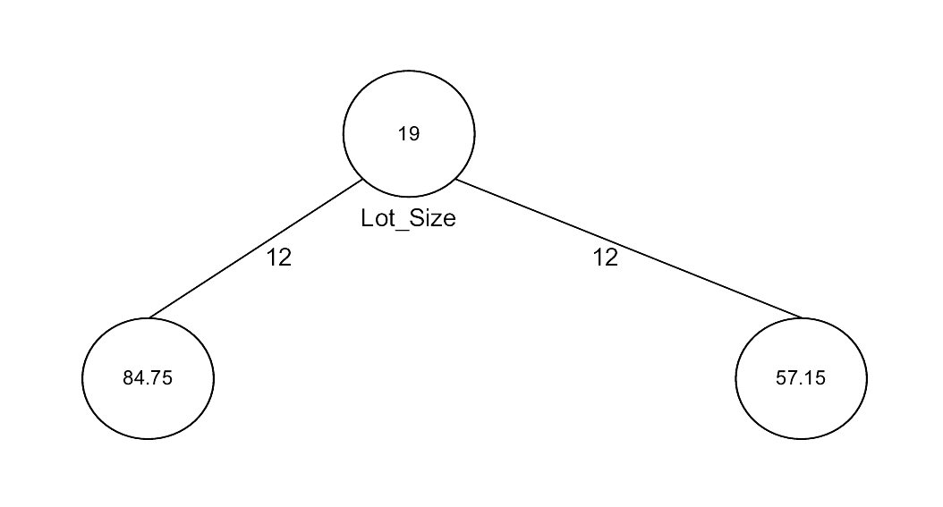
First Split – The Tree

Slide 19
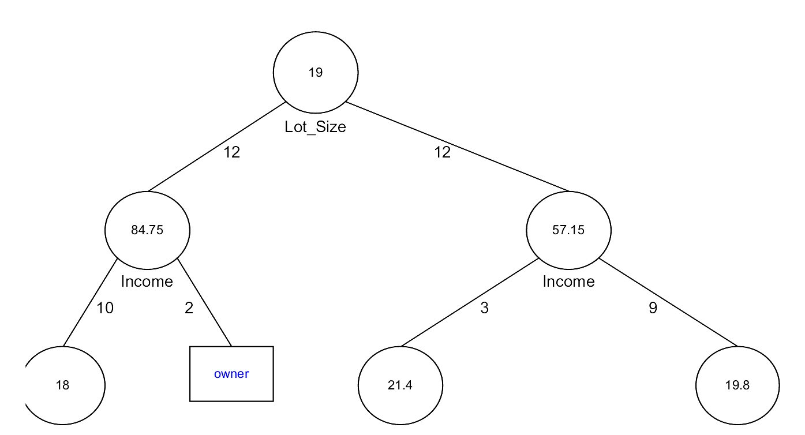
Tree after three splits

Slide 20
Tree Structure
Split points become nodes on tree (circles with split value in center)
Rectangles represent “leaves” (terminal points, no further splits, classification value noted)
Numbers on lines between nodes indicate # cases
Read down tree to derive rule
    E.g., If lot size < 19, and if income > 84.75, then class = “owner”

Slide 21
Determining Leaf Node Label
Each leaf node label is determined by “voting” of the records within it, and by the cutoff value
Records within each leaf node are from the training data
Default cutoff=0.5 means that the leaf node’s label is the majority class.
Cutoff = 0.75: requires majority of 75% or more “1” records in the leaf to label it a “1” node

Slide 22
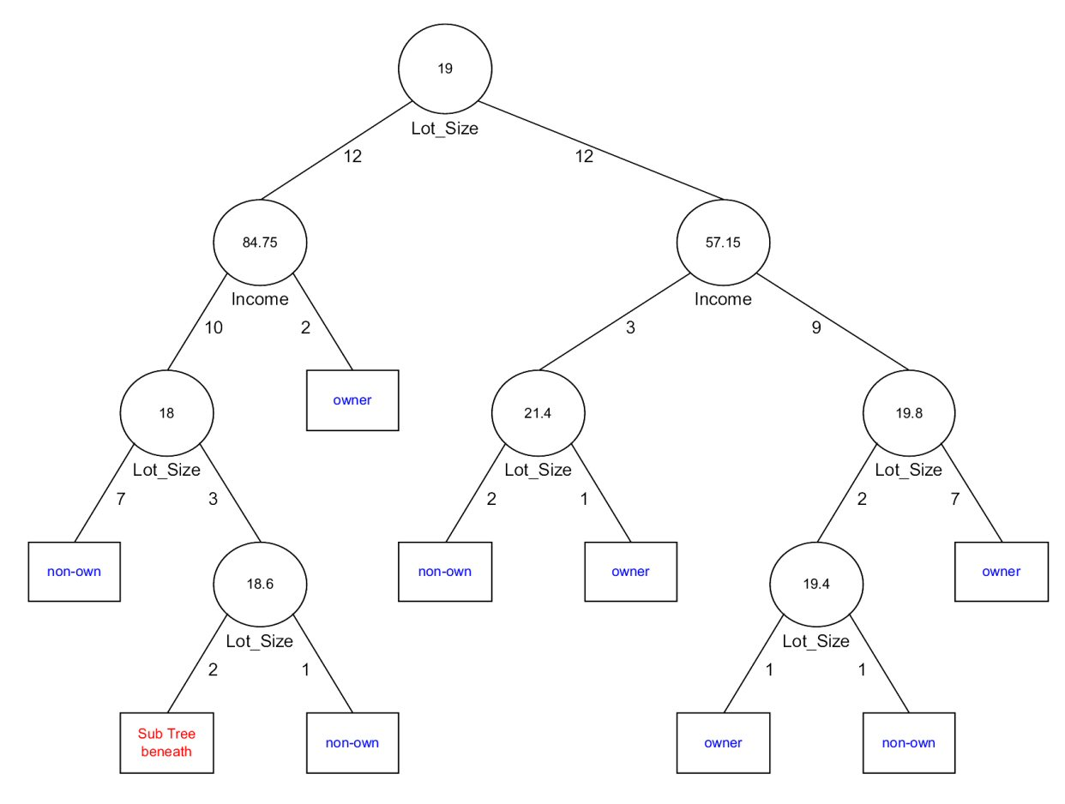
Tree after all splits

Slide 23
The Overfitting Problem

Slide 24
Stopping Tree Growth
Natural end of process is 100% purity in each leaf
This overfits the data, which end up fitting noise in the data
Overfitting leads to low predictive accuracy of new data
Past a certain point, the error rate for the validation data starts to increase

Slide 25
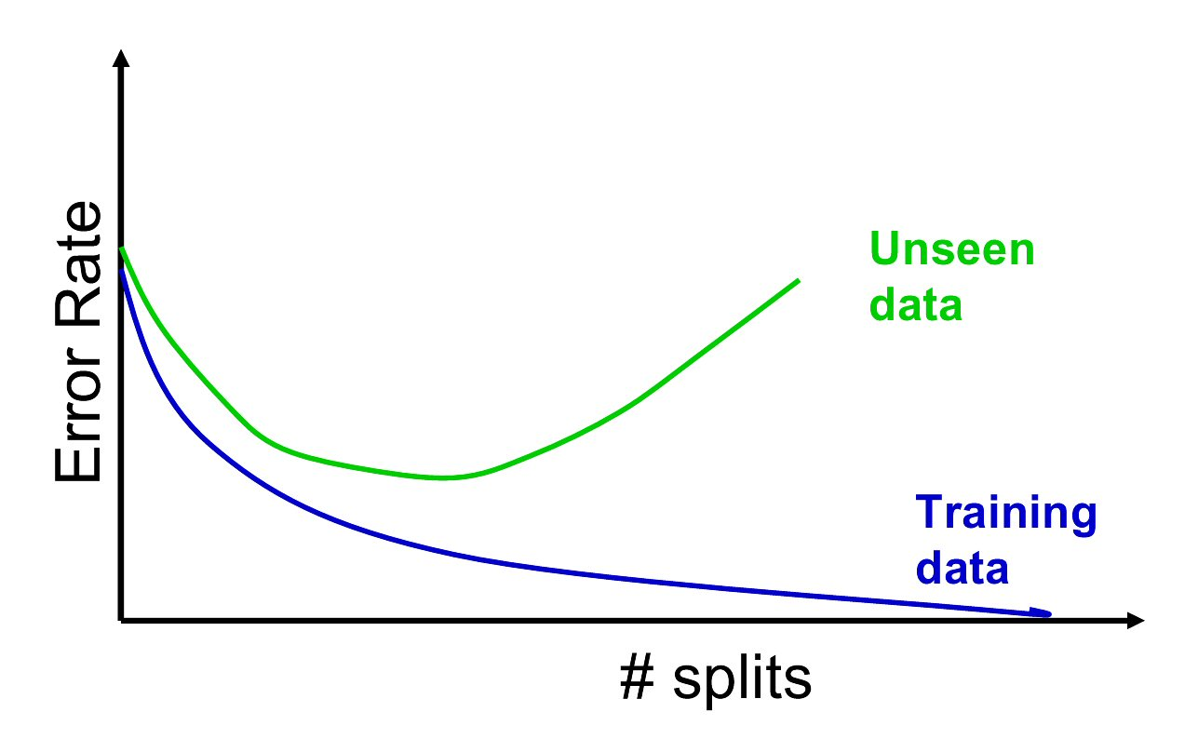
Full Tree Error Rate

Slide 26
CHAID
CHAID, older than CART, uses chi-square statistical test to limit tree growth
Splitting stops when purity improvement is not statistically significant

Slide 27
Pruning
CART lets tree grow to full extent, then prunes it back
Idea is to find that point at which the validation error begins to rise
Generate successively smaller trees by pruning leaves
At each pruning stage, multiple trees are possible
Use cost complexity to choose the best tree at that stage

Slide 28
Cost Complexity
CC(T) = Err(T) + α L(T)
CC(T) = cost complexity of a tree
Err(T) = proportion of misclassified records
α = penalty factor attached to tree size (set by user)
Among trees of given size, choose the one with lowest CC
Do this for each size of tree

Slide 29
Using Validation Error to Prune
Pruning process yields a set of trees of different sizes and associated error rates
Two trees of interest:
Minimum error tree
    Has lowest error rate on validation data
Best pruned tree
    Smallest tree within one std. error of min. error
    This adds a bonus for simplicity/parsimony

Slide 30
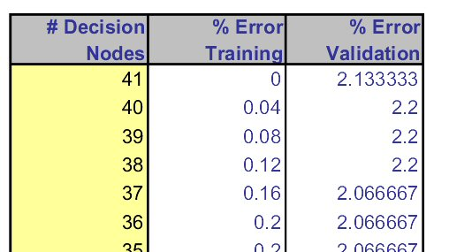
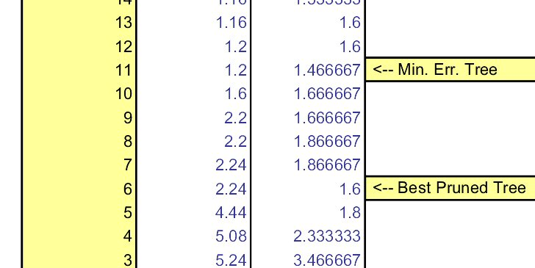
Error rates on pruned trees

Slide 31
Regression Trees

Slide 32
Regression Trees for Prediction
Used with continuous outcome variable
Procedure similar to classification tree
Many splits attempted, choose the one that minimizes impurity

Slide 33
Differences from CT
Prediction is computed as the average of numerical target variable in the rectangle (in CT it is majority vote)
Impurity measured by sum of squared deviations from leaf mean
Performance measured by RMSE (root mean squared error)

Slide 34
Advantages of trees
Easy to use, understand
Produce rules that are easy to interpret & implement
Variable selection & reduction is automatic
Do not require the assumptions of statistical models
Can work without extensive handling of missing data

Slide 35
Disadvantages
May not perform well where there is structure in the data that is not well captured by horizontal or vertical splits
Since the process deals with one variable at a time, no way to capture interactions between variables

Slide 36
Summary
Classification and Regression Trees are an easily understandable and transparent method for predicting or classifying new records
A tree is a graphical representation of a set of rules
Trees must be pruned to avoid over-fitting of the training data
As trees do not make any assumptions about the data structure, they usually require large samples

